Slide 2
Mikael Nystrom Viktor Hedberg
Building a Resilient Hybrid IT-Infrastructure - Minimize the Impact of a Breach

Slide 3
Agenda
The Network
Securing the control plane
Virtualization
Manage Windows Server
Securing the backup

Slide 4
Virtualization
VMware
Microsoft
Azure Stack HCI
Hyper-V
KVM

Slide 5

Isolate your Hypervisors (Tier -1)
Management interfaces
Separate Switches
Separate Network
Separate DNS
Separate AD forest
Also known as a fabric
High value target for TA’s

Slide 6
Common ways to attack and encrypt
Attack vCenter, SCVMM, AD, etc
Attack the host
Attack iLO/iDRAC
Kill service, encrypt random parts of all virtual disks, bottom up, first 1GB is always lost, then random blocks, destroying 100 servers takes 1-5 minutes

Slide 7
Common mistakes
Hypervisors with SSO in main AD
Same local name and password on all hosts
Same name and password used elseware
ILo/Idrac same name and password
No security monitoring
Management accessible from anywhere, including client VPN

Slide 8
Virtualization - Fundamentals
Be your own Service Provider
Build a Private Cloud
Isolated network, storage, hardware, IP
Accessible only from within the fabric
Self-service is Key

Slide 9
Azure Stack HCI + Azure Arc Bridge

Slide 10
Azure Stack HCI 23H2
Azure but Local
Control Plane in Azure
Build in Azure, deploy Local

Slide 11

Agenda
Install / Deploy
Configure the Physical Layer
Configure the Logical Layer
Manage Content
Extending functionality
Expanding the platform

Slide 12

Prep your Azure AD
Make sure your Resource Groups are created (at least one)
Your need to have permissions in the OU, to create “things”
You need to have SubscriptionID
You need to have TennentID

Slide 13
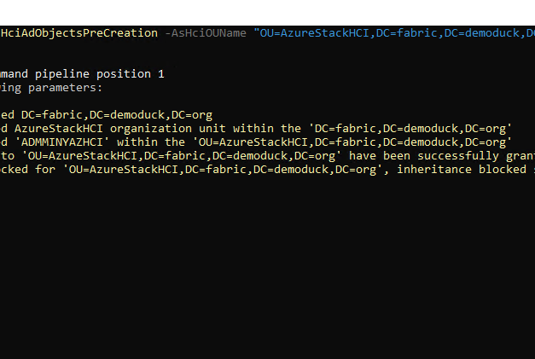
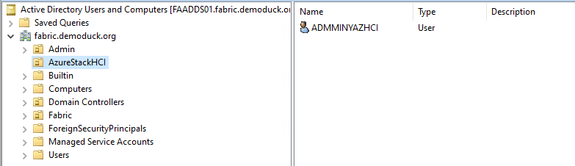
Prep your Active Directory
Create OU and Admin, then sets permission

Slide 14
Deploy Hosts
Configure hardware
UEFI, Secure Boot, TPM, Disks, Supported Network Adapters (connected), Correct POWER Setting
Download ISO, Boot on ISO, Install Azure Stack HCI
Select TimeZone, Verify TIME, “know” your network configuration
Network is divided in Compute, Management and Storage, Storage runs on VLAN
Plan your network before deploying!
NOTE!!!
Do NOT Patch
Do NOT join to AD

Slide 15
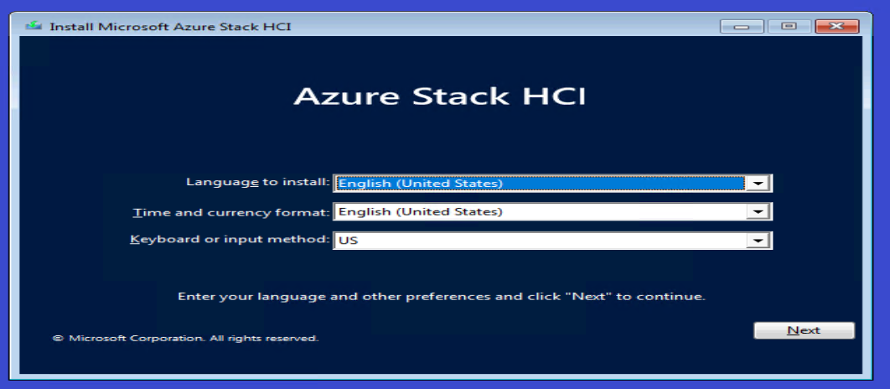
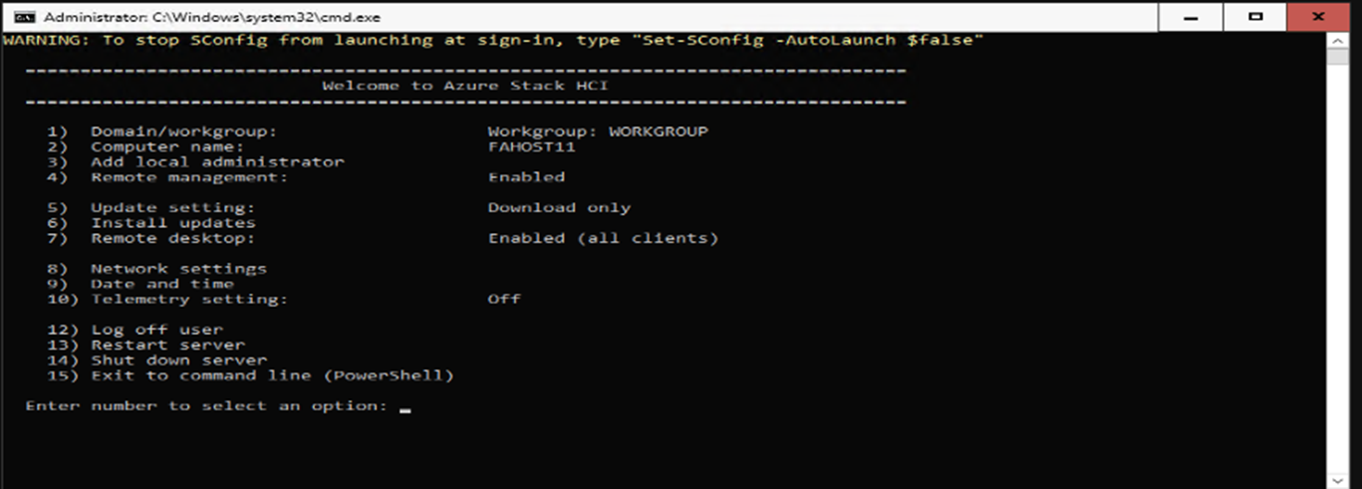
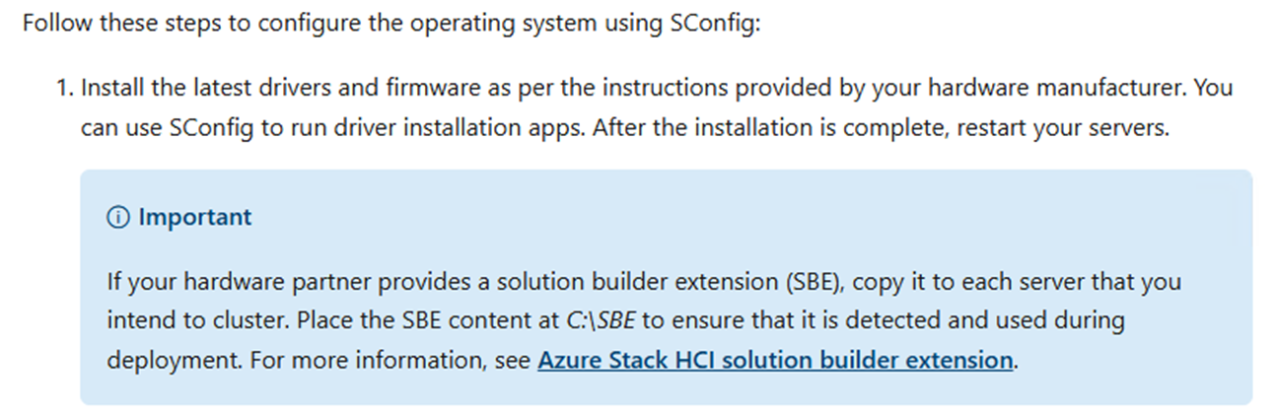
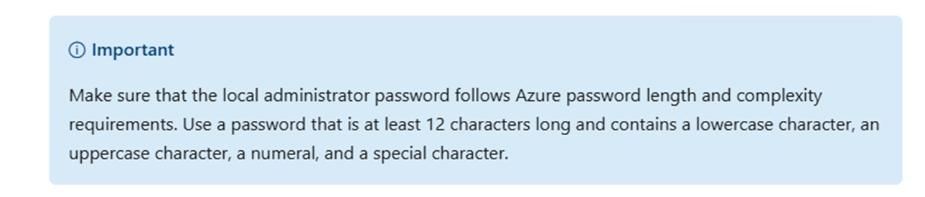
Install the OS

Slide 16
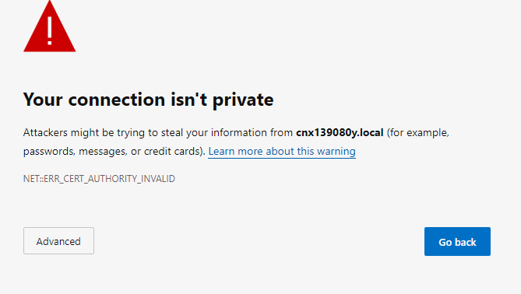
Configure the node using the new UI
Connect to host using http://SERVERNAME.local

Slide 17
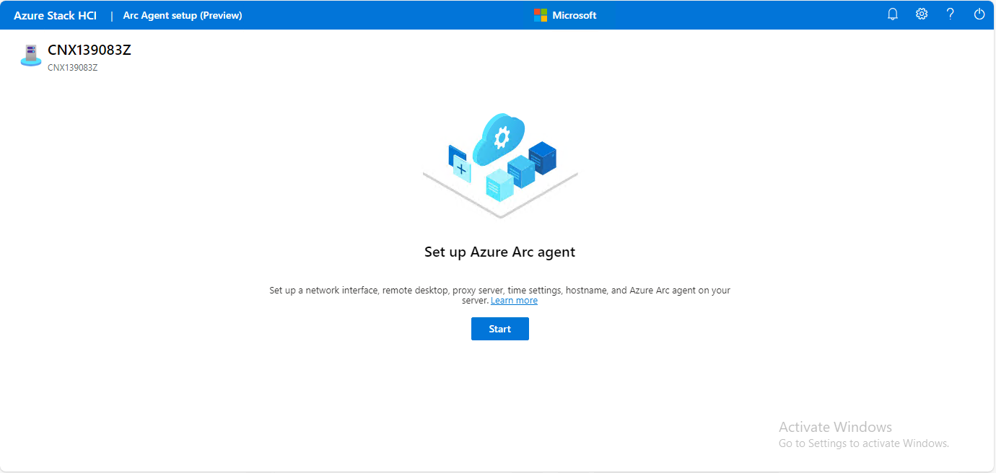
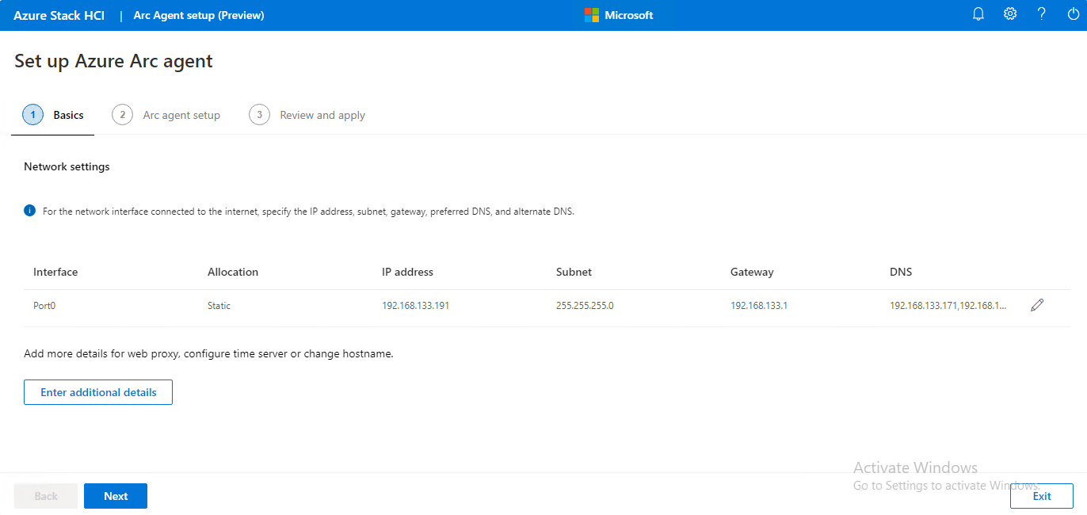
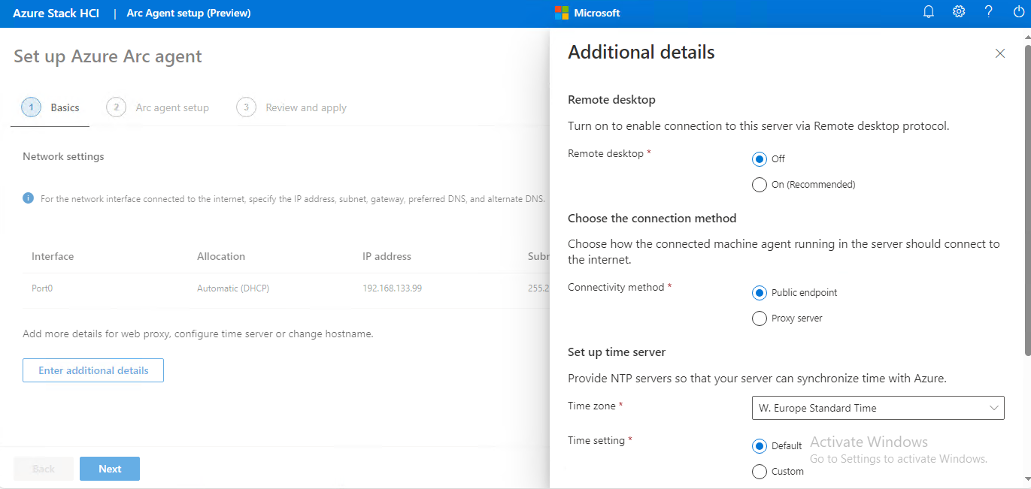
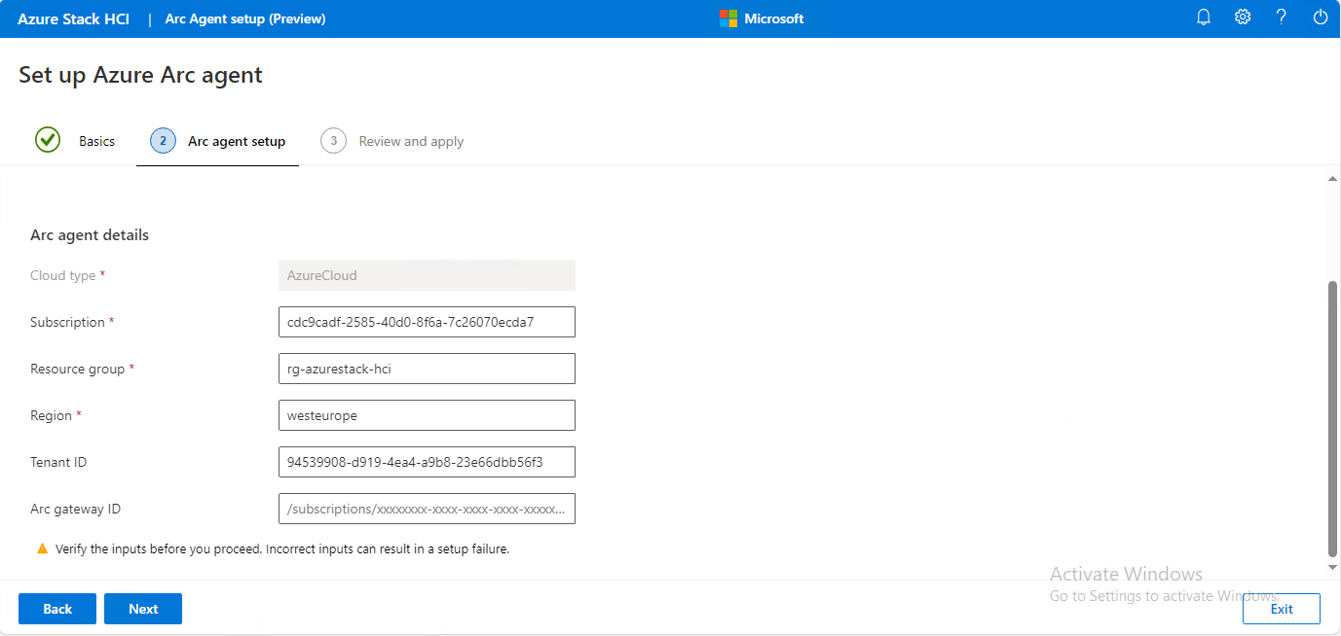
Configure it

Slide 18
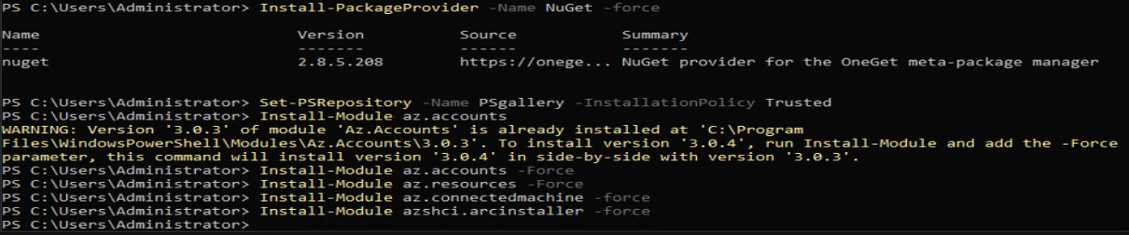
If you prefer the “old” way -use PowerShell

Slide 19
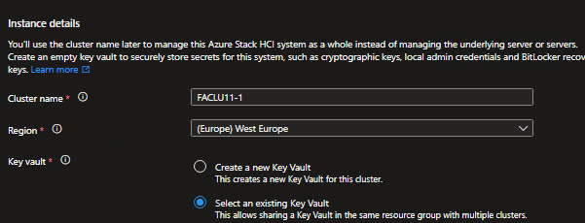
The rest happens in Azure...

Slide 20
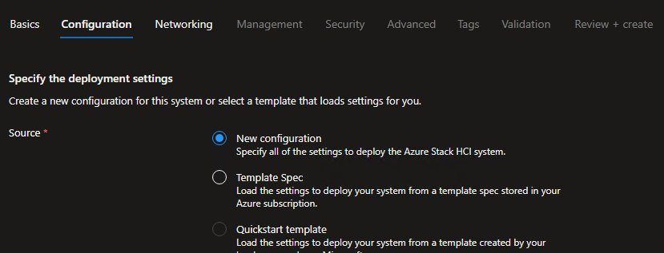
The rest happens in Azure...

Slide 21
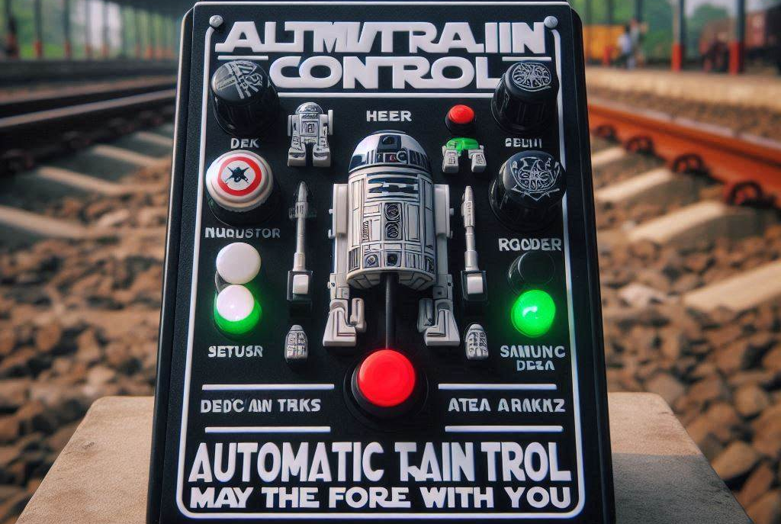
ATC = Automatic Train Control?
Reduce host networking deployment time, complexity, and errors
Deploy the latest Microsoft validated and supported best practices
Ensure configuration consistency across the cluster
Eliminate configuration drift

Slide 22
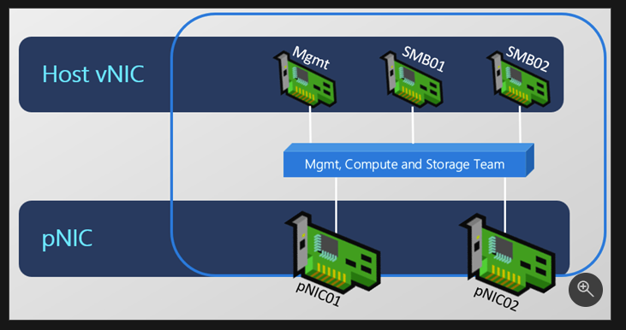
Fully converged intent

Slide 23
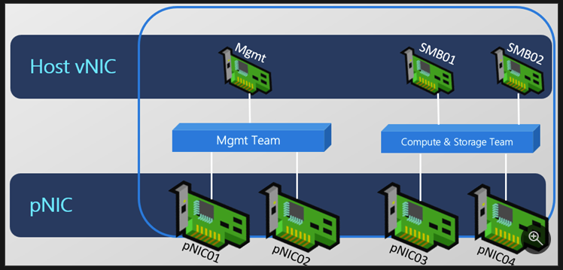
Converged compute and storage intent with sseparate management intent

Slide 24
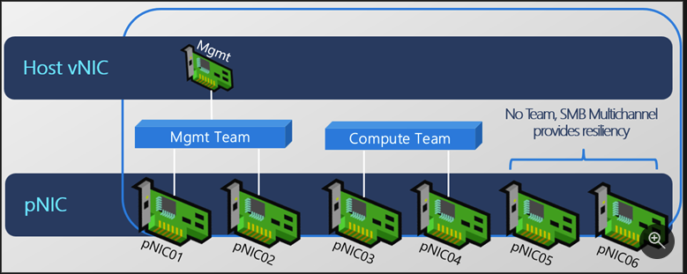
Fully disaggregated intent

Slide 25
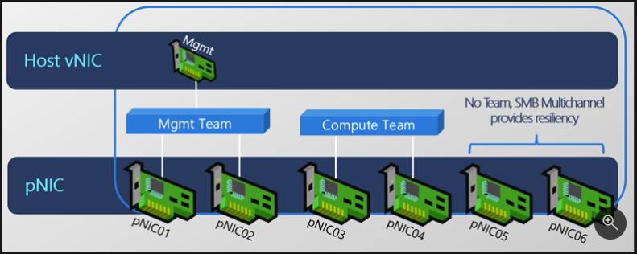
Storage-only intent

Slide 26
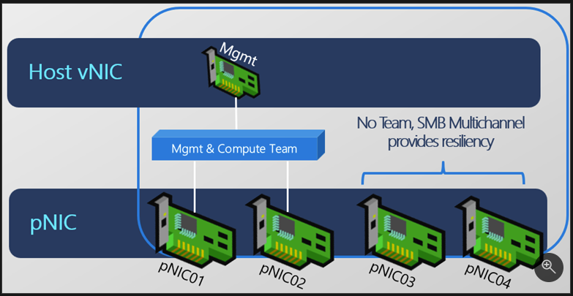
Compute and management intent

Slide 27
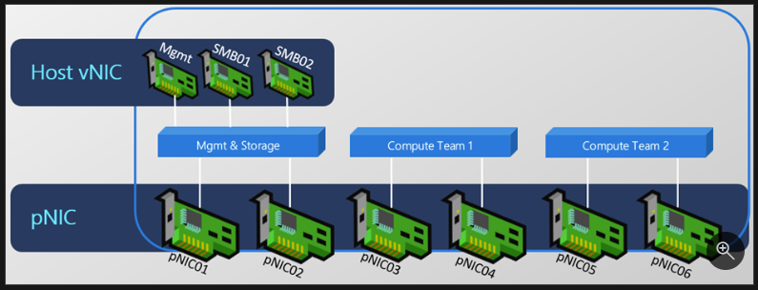
Multiple compute (switch) intents

Slide 28
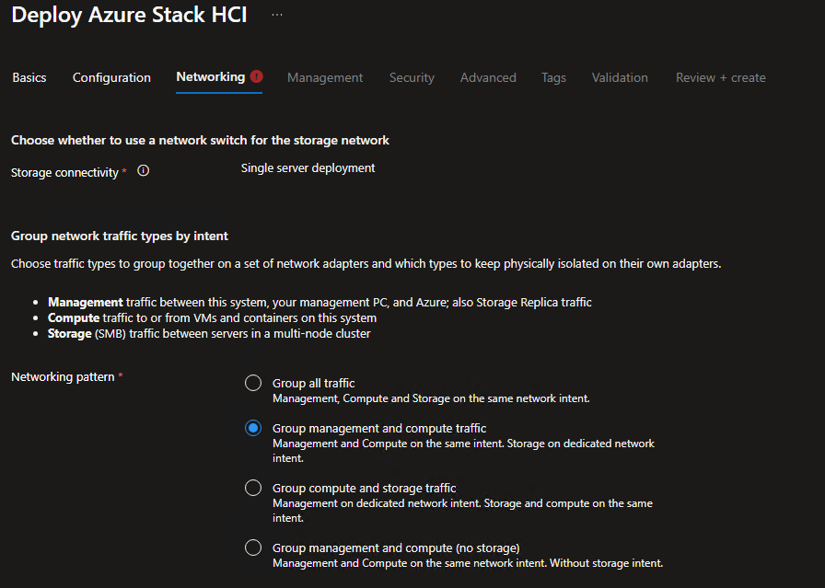
The rest happens in Azure...

Slide 29
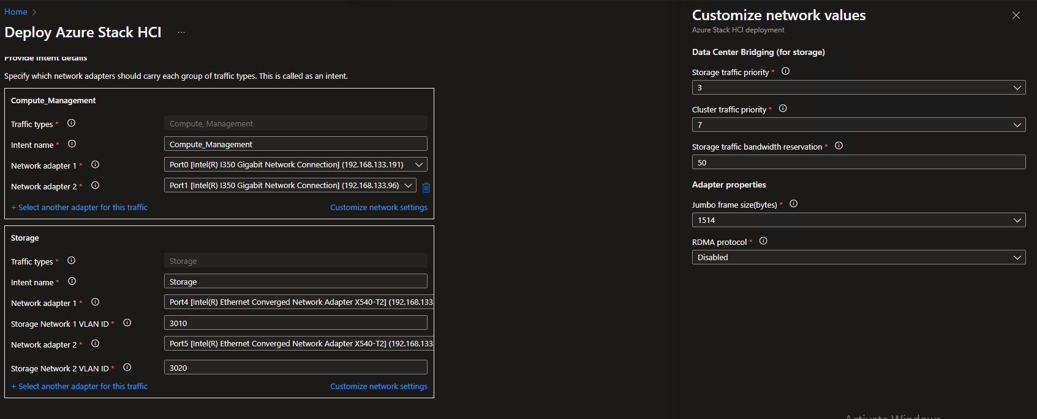
The rest happens in Azure...

Slide 30
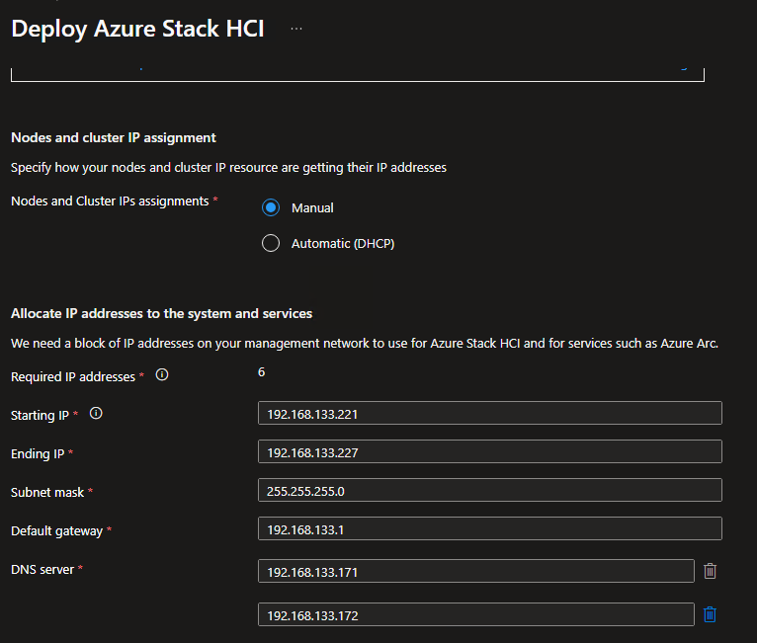
The rest happens in Azure...

Slide 31
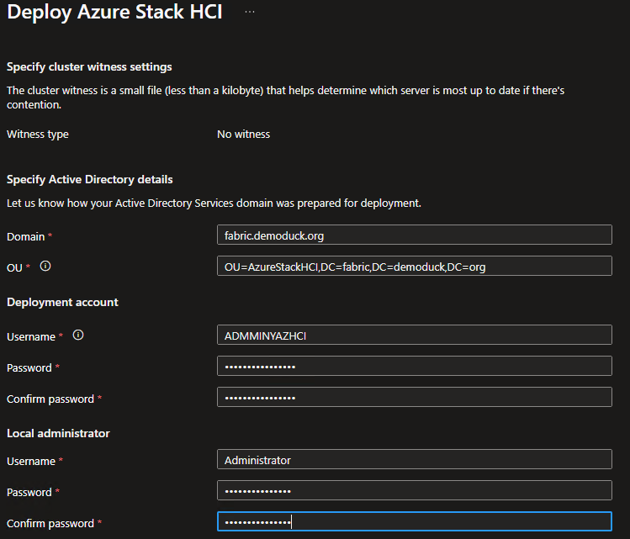
The rest happens in Azure...

Slide 32
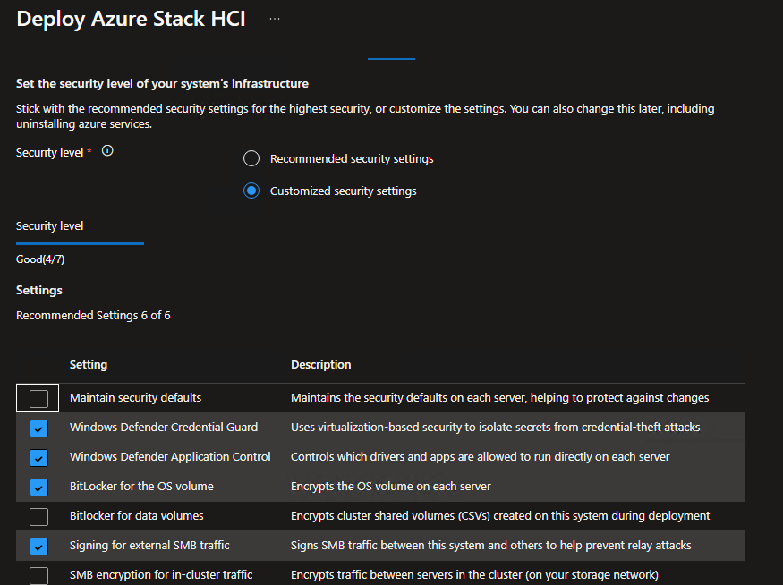
The rest happens in Azure...

Slide 33
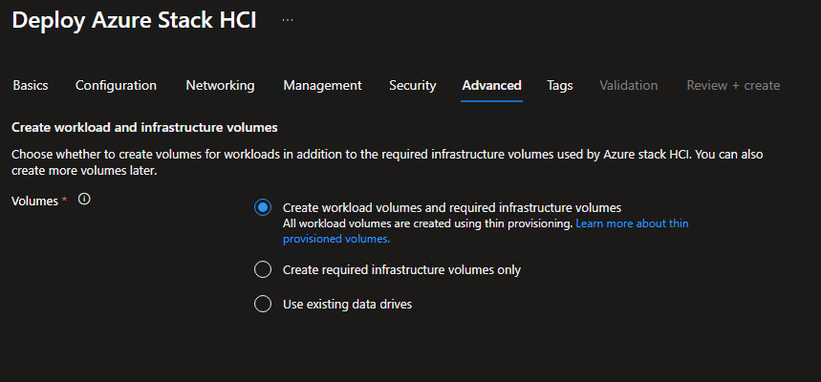
The rest happens in Azure...

Slide 34
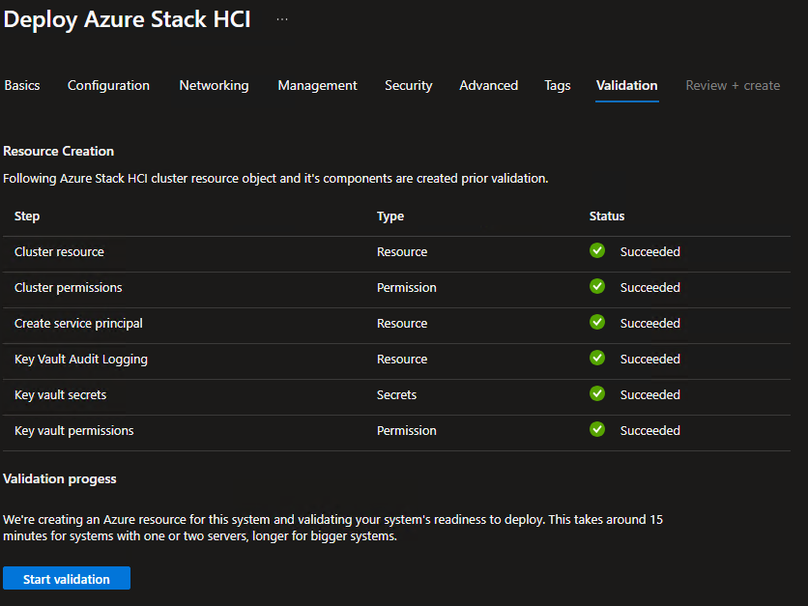
The rest happens in Azure...

Slide 35
Validation is done, lets move on

Slide 36
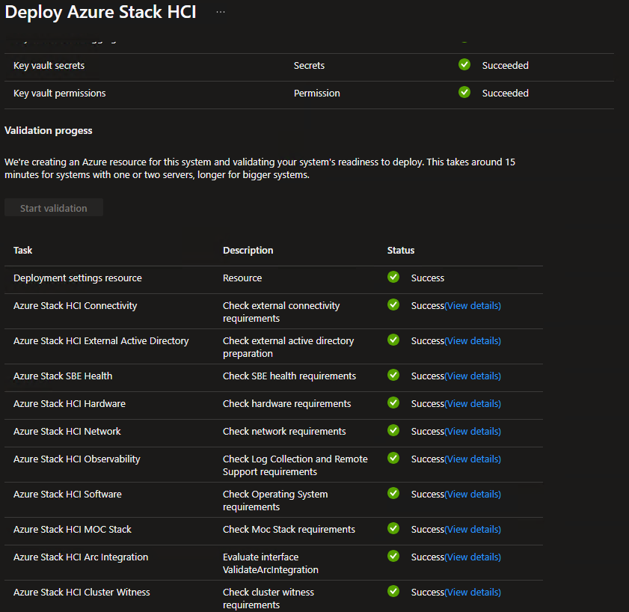
The rest happens in Azure...

Slide 37
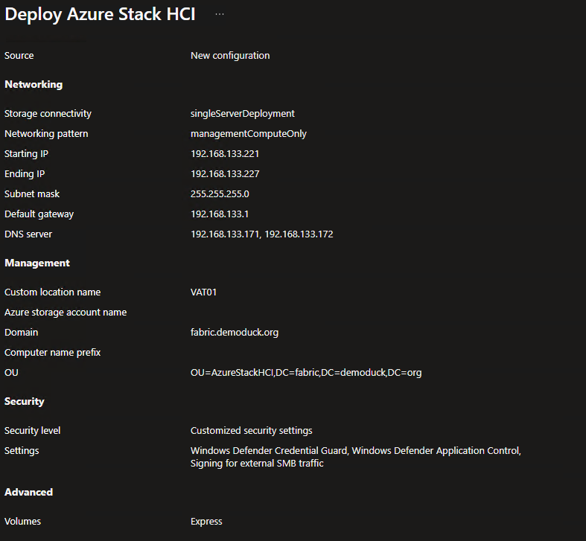
The rest happens in Azure...

Slide 38
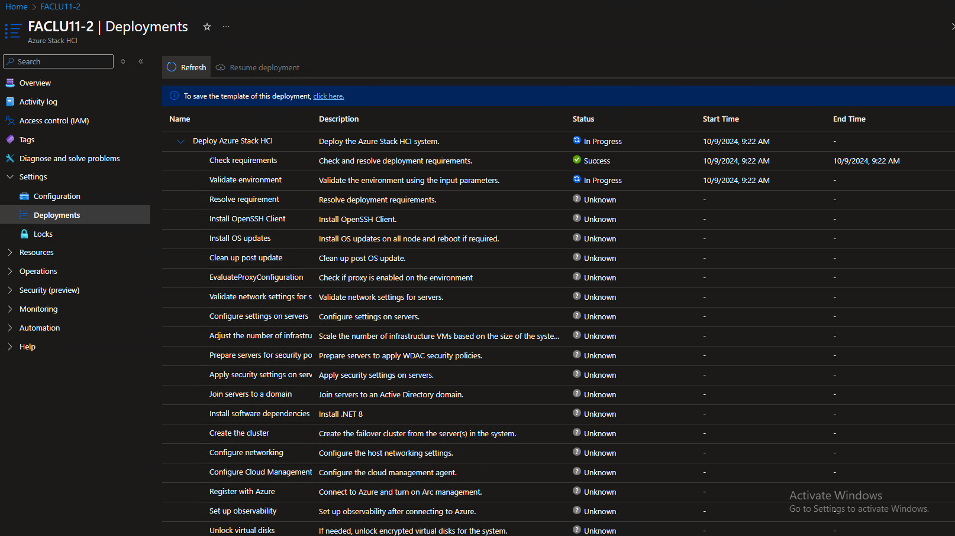
The rest happens in Azure...

Slide 39
Lets look in the host, just for fun

Slide 40
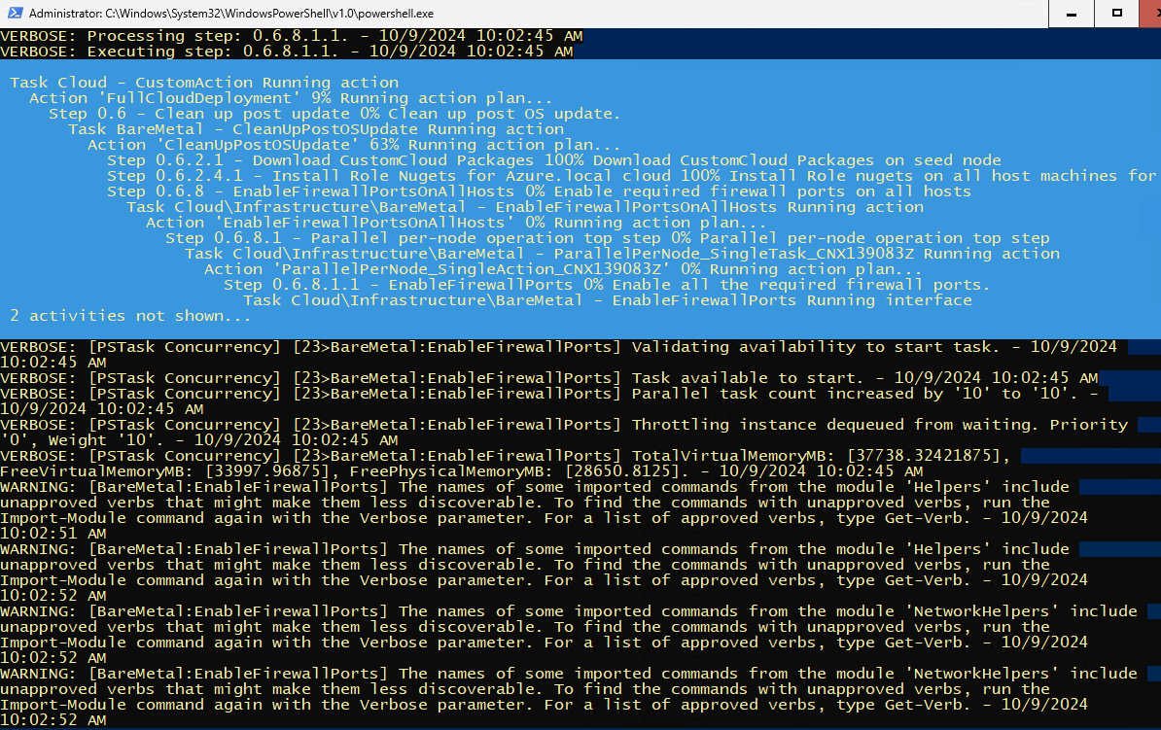

Slide 41
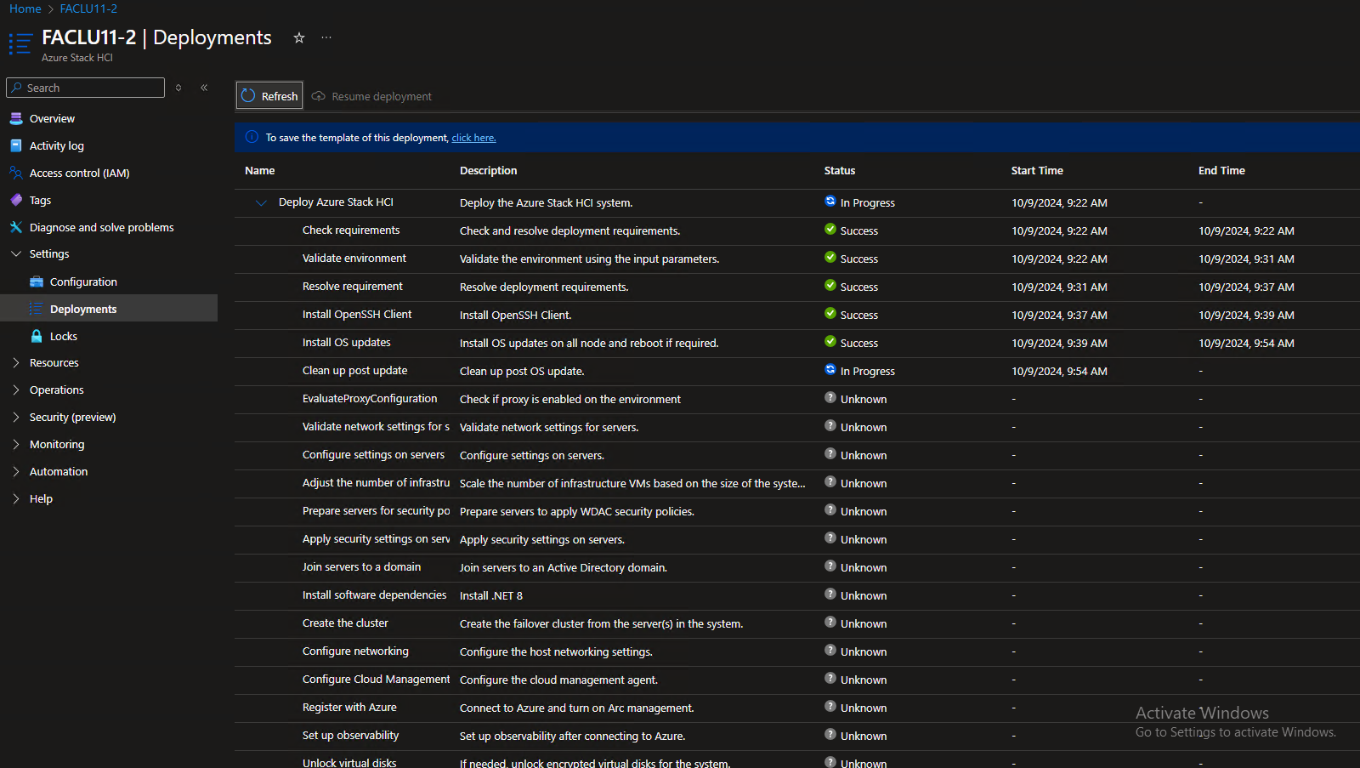
The rest happens in Azure...

Slide 42
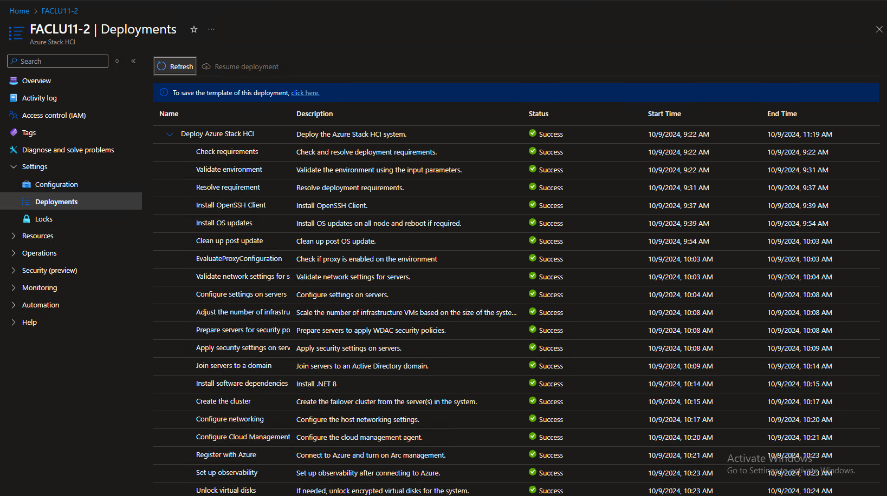
The rest happens in Azure...

Slide 43
Let it “bake” for a few “hours”
Storage will be configured
Network will be configured
Information will be synced

Slide 44
Configure the Physical Layer
Configure Storage
Thick vs Thin
Configure Security
BitLocker
Baseline
Tools to use
Windows Admin Center
Azure Portal

Slide 45
Configure the Logical Layer
Create logical network
Disk images

Slide 46
Extending functionality
Azure Virtual Desktop
Kubernetes Cluster
Azure Automanage

Slide 47

Expanding a HCI cluster...or maybe not...
Yes, it supported
Yes, it comes with a risk
No, I will not do it

Slide 48
The risk
Adding a node
Identical
Unable to fully validate configuration in some cases
Adding memory
Just add
Adding CPU
Just add

Slide 49
The risk
Adding disk
Tricky, but possible
Adding Network Adapter
Tricky, needs to be added in multiple locations

Slide 50
Instead...
Add a new cluster
Easy
Does not affect existing env:
Scales better
Always run on the “latest” hardware
Gives more then “one” cluster
Fits into lifecycle management

Slide 51
Hyper-V and SCVMM + Azure Arc Bridge

Slide 52
HowTo
Separate AD
Build Hyper-V nodes any way you want
Configure Networking SMB Direct, RDMA, etc
Join to Domain
Add to SCVMM
Deploy Azure Arc Bridge

Slide 53
Vmware + Azure Arc Bridge

Slide 54
HowTo
Separate AD
Build VMware nodes any way you want
Configure Networking, RDMA, etc
Join to vCenter
Deploy Azure Arc Bridge

Slide 55
Dark, media right

Slide 56
Chapter

